Slide 1



Surakshya
Ensuring safety compliance

Slide 2

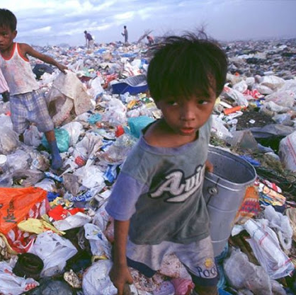
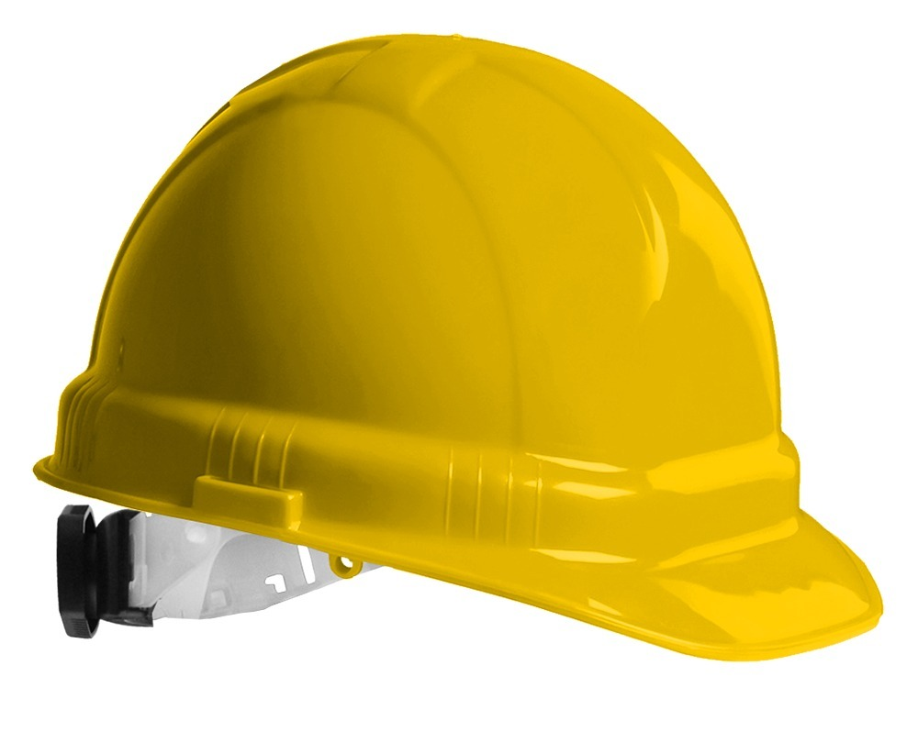
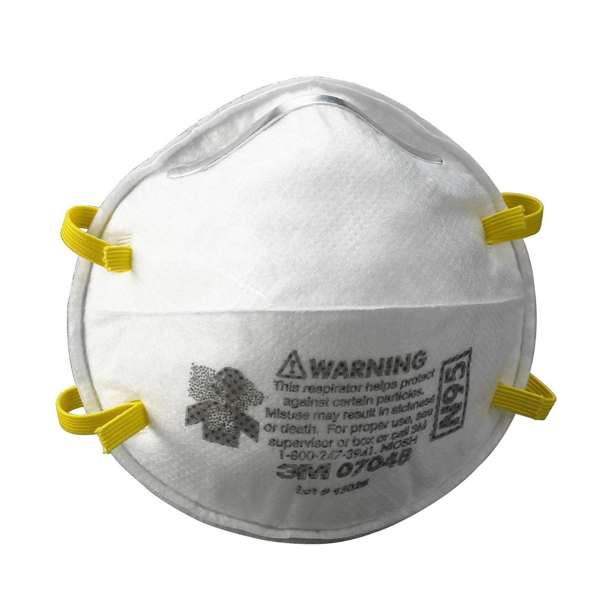
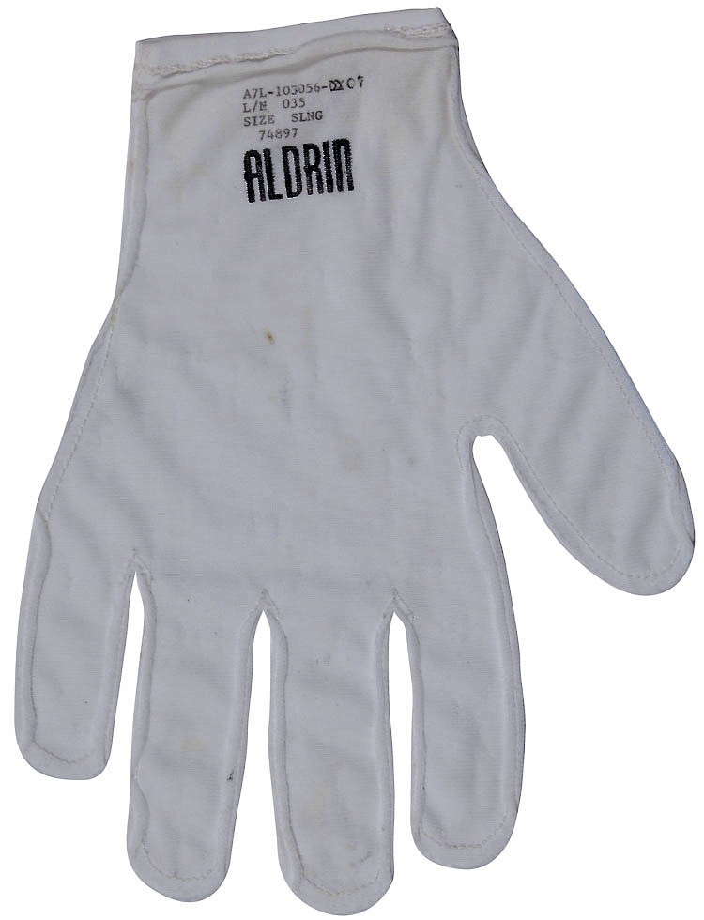
Why Personal Protective Equipments (PPEs) in Landfill sites?
Injuries
Illness
Public health risk

Slide 3
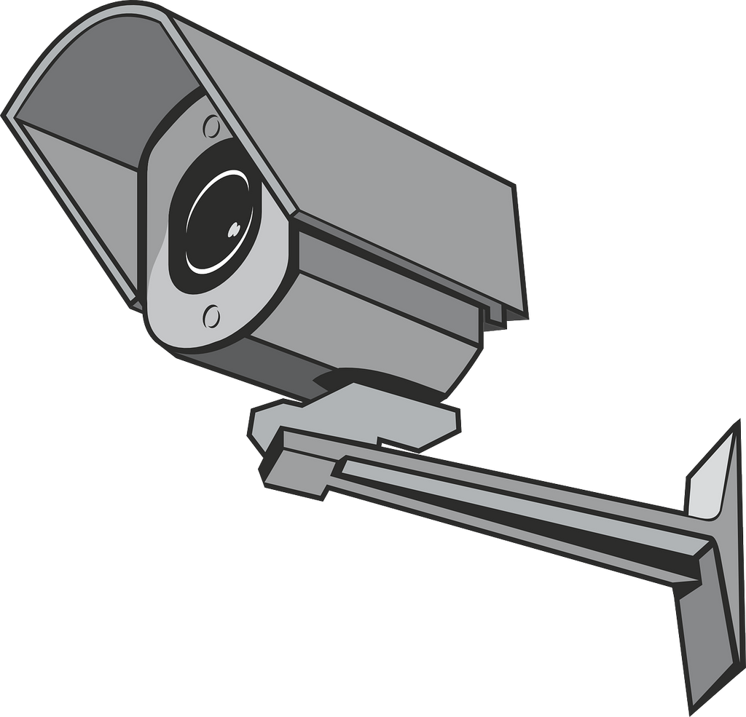
Compliance?
Object Detection
Facial Recognition
Motion tracking

Slide 4
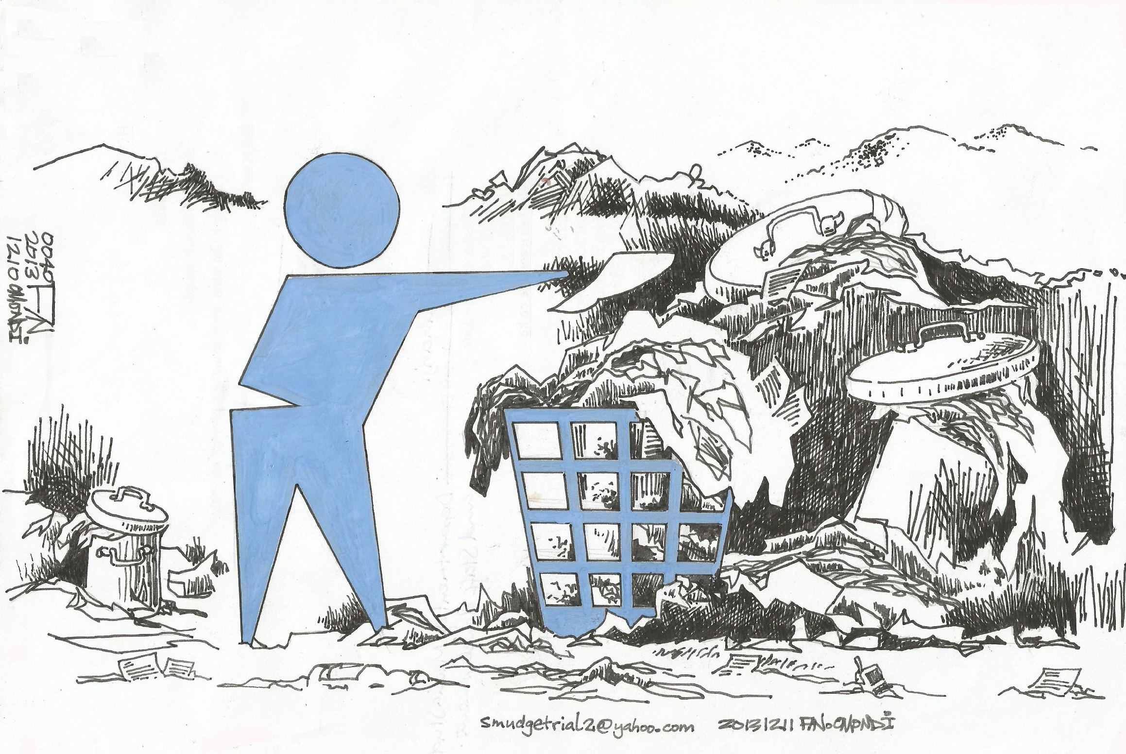
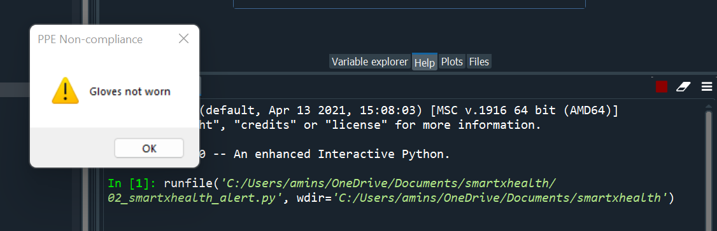
Phase 1: Object Detection

Slide 5
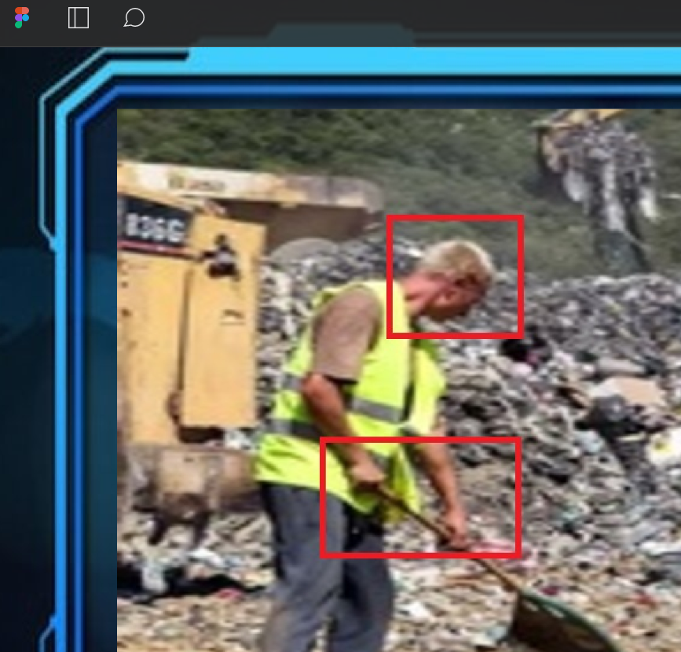
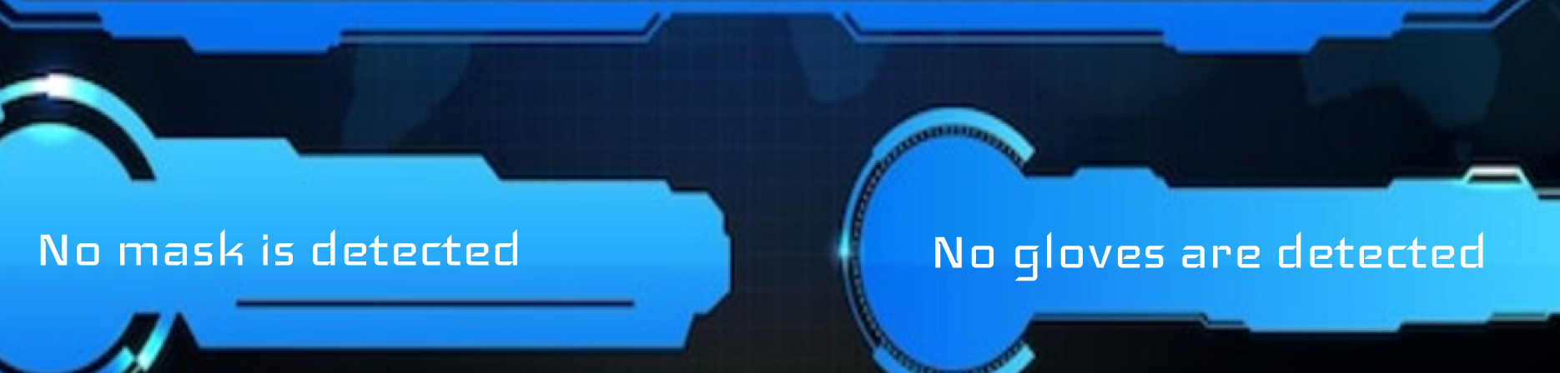
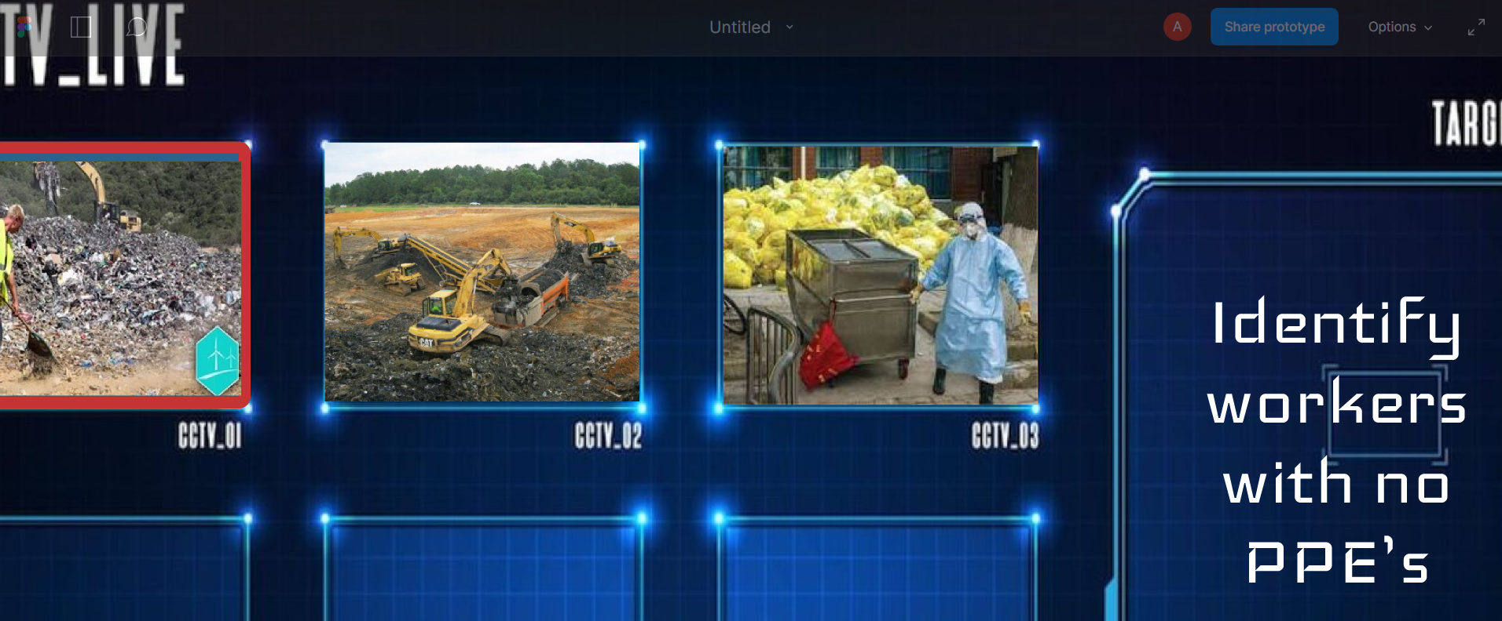
Phase 1: Object Detection

Slide 6


Phase 2: Facial Detection
Phase 3: Motion Tracking

Slide 7
Unique Selling Point
Minimum Viable Product
Tech for safety compliance
PPE detection ML model

Slide 8
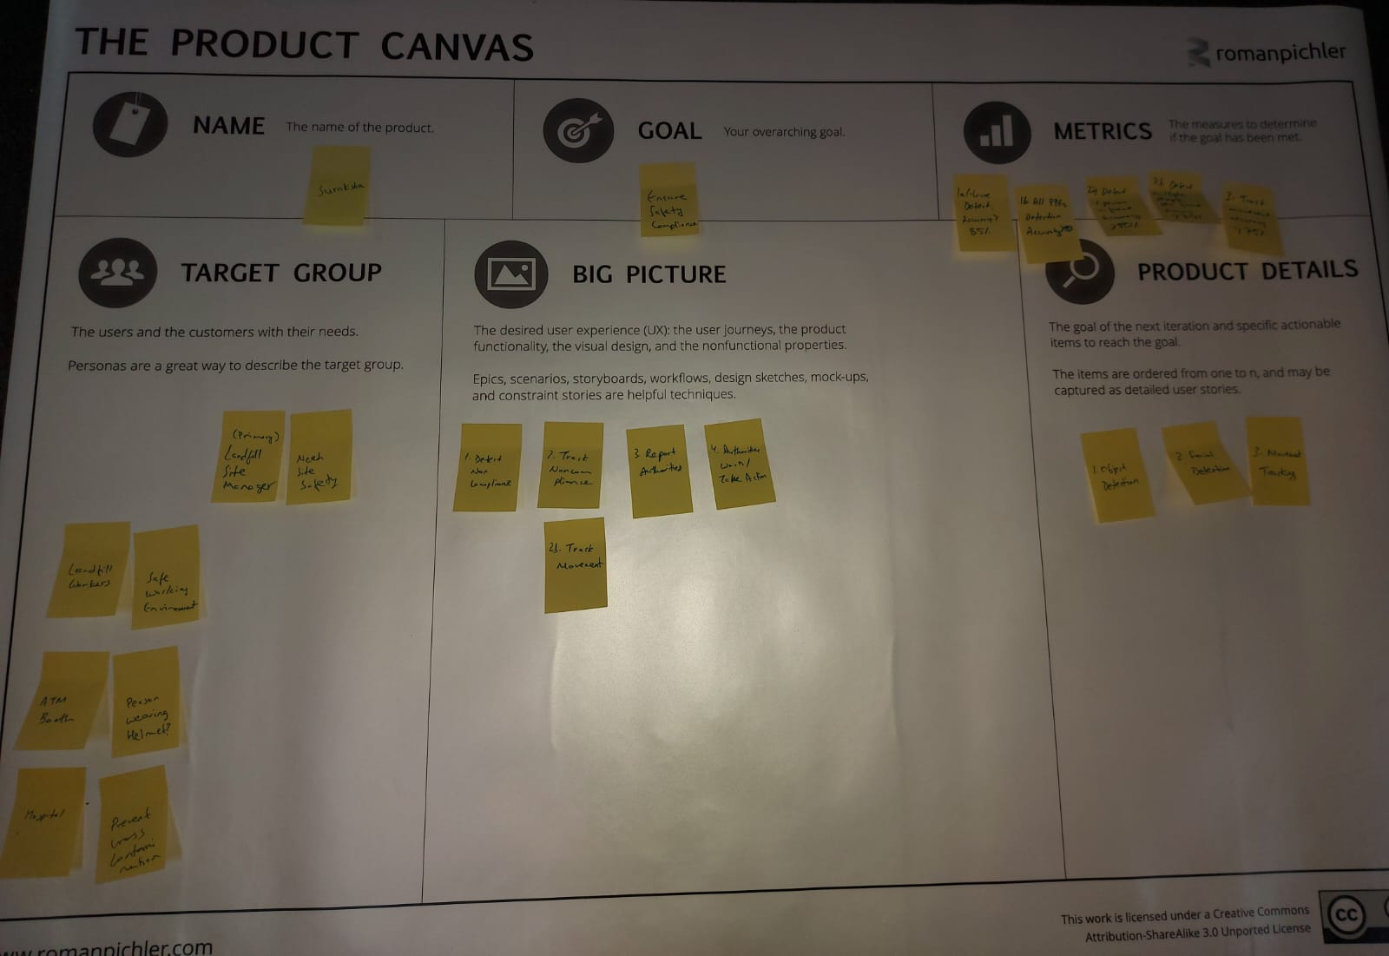
The Product Canvas

Slide 9
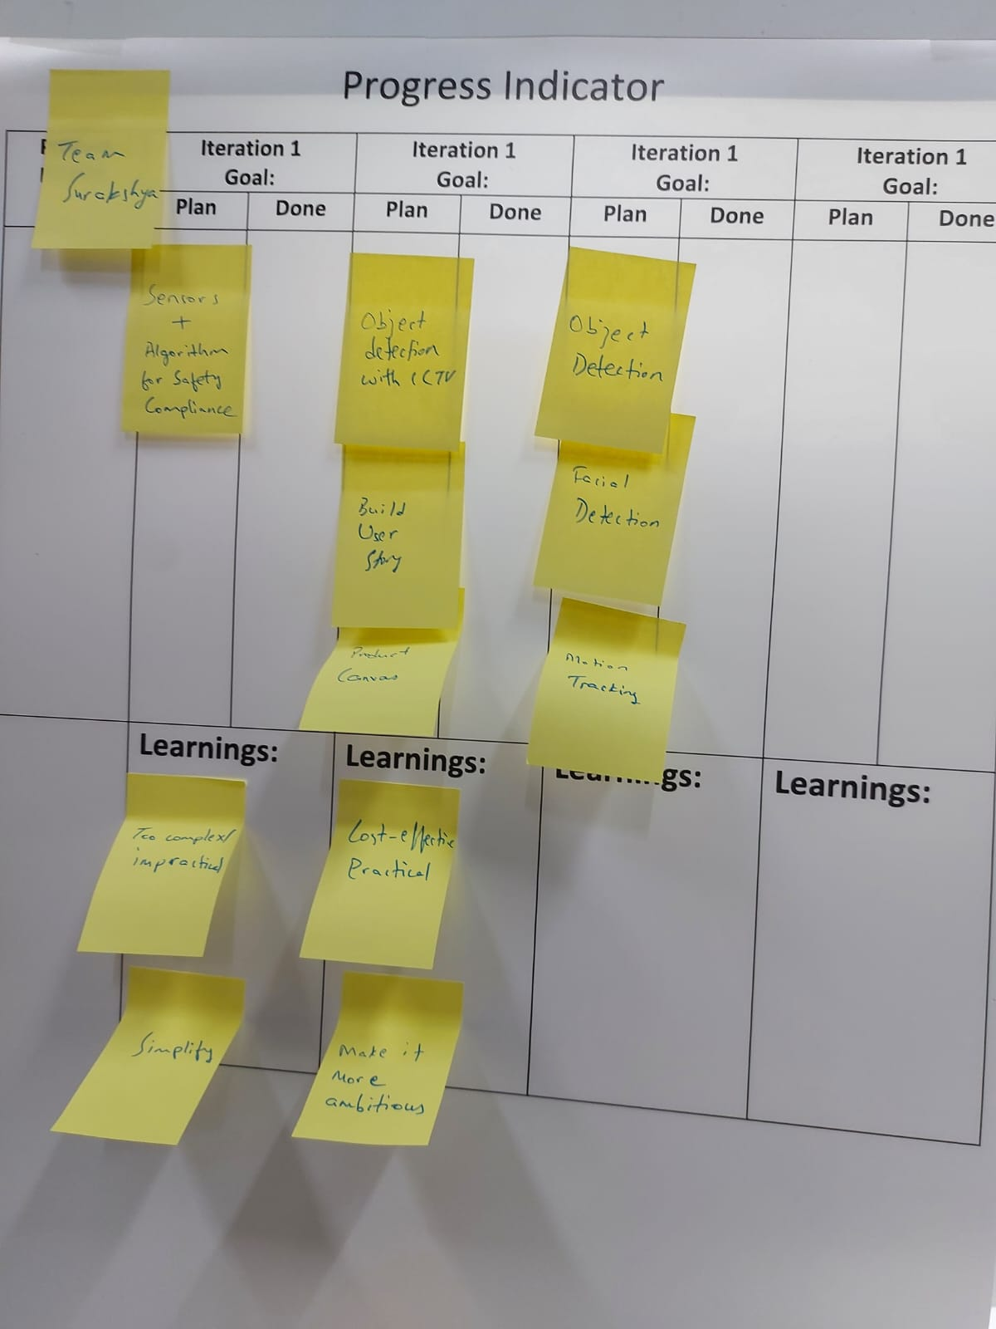
Progress Indicator

Slide 10

Our Team
Amin Shakya, Water Eng.
Harsh Ratna Sawant, Mechanical Eng.
BA Vinod, Electronics Eng.
https://github.com/mn5hk/smartxhealth_suraksha

